Slide 1
1-D Heat Transfer Problem
Collaborative exchange Communication

Slide 2
1-D Heat Transfer Problem
Utilizing MPI_Sendrecv()
MPI_Sendrecv() is a collaborative communication routine that allows one to communicate data in both directions between two MPI Processes
It must be appropriately paired with another MPI_Sendrecv() routine on another MPI process in much the same way as MPI_Send()’s, MPI_Recv()’s but the internal send/rec ordering is handled internal to the routine.
Using it produces the most concise implementation of this problem

Slide 3
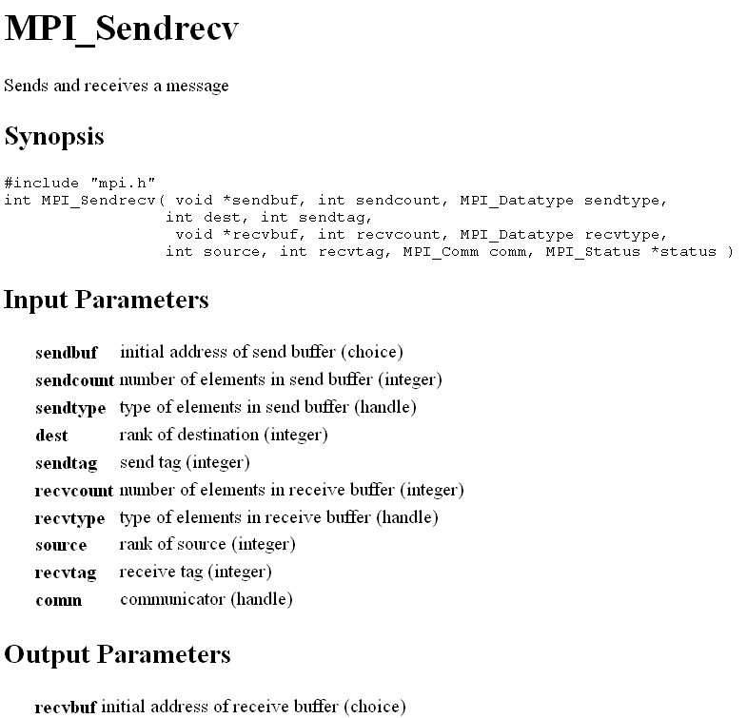

Slide 4
